Slide 1
Explainable AI for Baseball Predictions and Strategies
2021 SABR Analytics Conference
Joshua Silver
Singlearity joshua.silver@singlearity.com
Tate Huffman
Harvard University
thuffman@college.harvard.edu

Slide 2
Acknowledgements
SABR: Organizing this conference
Baseball Savant: Providing access to Statcast data
Baseball Prospectus: Providing a forum for baseball analytics enthusiasts
Daniel Ursin: Documenting algorithms for Markov Chains
2021 SABR Analytics Conference

Slide 3
Overview
AI
Explainable
Strategies
Generate better predictions by using AI to incorporate more data
Provide rationale for predictions
Create actionable strategies around lineup optimization, pinch hitters, relief pitchers & more
2021 SABR Analytics Conference

Slide 4
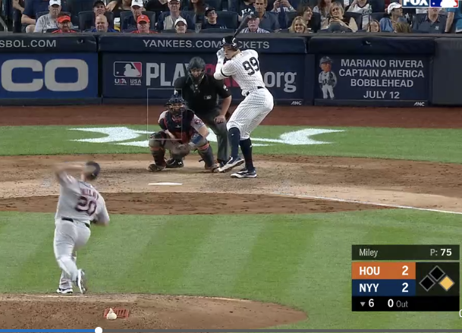
Predicting the Outcome of a Plate Appearance
Critical to other decisions:
Pinch hitter & relief pitcher selection
Roster composition
Rest days
Complex:
Lefty/Righty “platoon” effects
Park factors
Weather
…and more
2021 SABR Analytics Conference

Slide 5
Previous Work
log5
Uses batter stats, pitcher stats and league average stats to predict a PA outcome
History of log5 Created by Bill James to predict the head-to-head outcome of two teams Extended to predict hit vs. no-hit result of plate appearance Generalized by Matt Haechrel to predict probabilities of 7 different outcomes (1B, 2B, 3B, HR, BB, HBP, out)
Limitations of log5 Works well only for matchups between “everyday” players (>=502 PAs in last 365 days). Ignores platoon effects, ballpark factors, weather, game context, etc. Predictions are not precise. It can predict an out but doesn’t distinguish between K, DP, SF, for instance.
2021 SABR Analytics Conference
Notes:
Haechrel uses 365-day average rate-per-plate appearance

Slide 6
Artificial Intelligence and Neural Networks
2021 SABR Analytics Conference

Slide 7
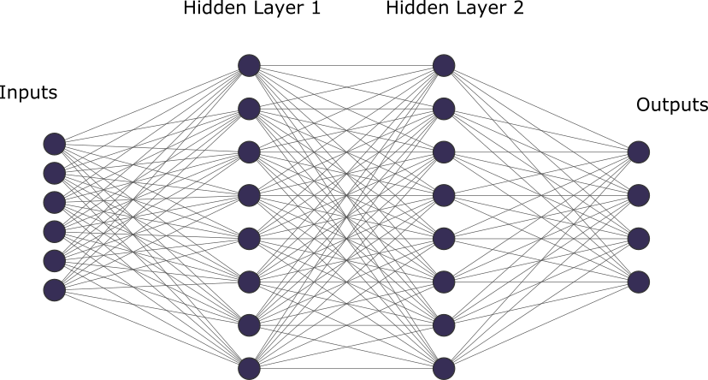
Neural Networks
Description AI technique that mimics human brain Identifies patterns and relationships using vast amounts of data | Implementation Trained on data by giving it “correct” answers to input “Training” means neural network determines weights of each edge Accuracy is measured by asking neural network to predict results for previously unseen inputs
Edges
2021 SABR Analytics Conference

Slide 8
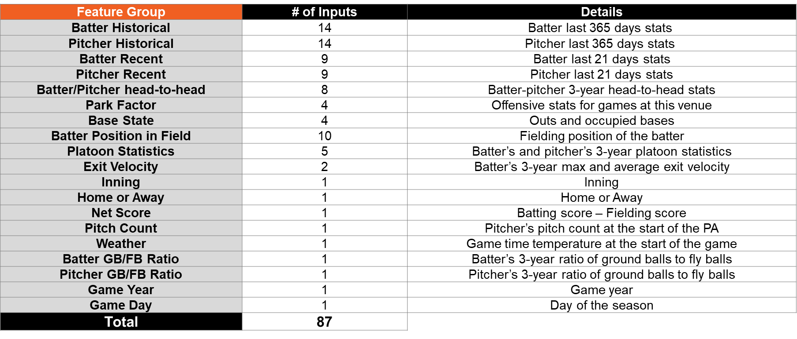
Singlearity-PA Technique
21 Outputs
87 Inputs
Probabilities for non-overlapping outcomes:
1B, 2B, 3B, HR, BB, IBB, HBP, E, K,
catcher interference, sacrifice bunt, sacrifice fly, field out, force out, fielder’s choice out, fielder’s choice, ground into double play, double play, sacrifice fly double play, strikeout double play, triple play
Training Uses regular season Statcast data from 2011-2020 1.72M plate appearances Split calendar days: 60% training data, 20% validation data, 20% test data Aggregated stats (e.g. BA and wOBA) calculated based on probabilities of PA outcome
2021 SABR Analytics Conference
Notes:
Used categorical cross-entropy as the loss function so that the neural network learned to accurately predict the probabilities of the 21 different PA outcomes.

Slide 9
Singlearity-PA Technique: Inputs
Feature Group | # of Inputs | Details
Batter Historical | 14 | Batter last 365 days stats
Pitcher Historical | 14 | Pitcher last 365 days stats
Batter Recent | 9 | Batter last 21 days stats
Pitcher Recent | 9 | Pitcher last 21 days stats
Batter/Pitcher head-to-head | 8 | Batter-pitcher 3-year head-to-head stats
Park Factor | 4 | Offensive stats for games at this venue
Base Out State | 4 | Outs and occupied bases
Batter Position in Field | 10 | One-hot encode valued of batter’s position(P,1B,…,DH)
Platoon Statistics | 5 | Batter’s and pitcher’s 3-year platoon statistics
Exit Velocity | 2 | Batter’s 3-year max and average exit velocity
Inning | 1 | Inning
Home or Away | 1 | Home or Away
Net Score | 1 | Batting score – Fielding score
Pitch Count | 1 | Pitcher’s pitch count at the start of the PA
Weather | 1 | Game time temperature at the start of the game
Batter GB/FB Ratio | 1 | Batter’s 3-year ratio of ground balls to fly balls
Pitcher GB/FB Ratio | 1 | Pitcher’s 3-year ratio of ground balls to fly balls
Game Year | 1 | Game year
Game Day | 1 | Day of the season
Total | 87
2021 SABR Analytics Conference
Notes:
Batter and Pitcher historical stats used are:
(1)# of PA
(10)Rates per PA for: 1B, 2B, 3B, HR, BB, IBB, HBP, GDP, SO, SF, SH
(1) wOBA
(1) Average park factor of PAs
(1) Imputed
Batter and pitcher recent stats used are:
(1) # of PA
(5) Rates per PA for: 1B, 2B, HR, BB, SO
(1) wOBA
(1) Average park factor of PAs
Imputed
Batter/Pitcher head-to-head stats used are:
(1) # of PA
(5) Rates per PA for: 1B, 2B, HR, BB, SO
(1) wOBA
(1) Imputed
Park factor stats used are:
(4) ESPN ballpark factors values averaged over the last 3 years for 1B, 2B, 3B, HR
Platoon stats used are:
Lefty/Righty matchup
(1) # of batter PA against this handed pitcher
(1) Batter's wOBA against this handed pitcher
(1) # of pitcher PA against this handed batter
Pitcher’s wOBA against this handed batter
In several categories, we include an imputed” input (of type Boolean) which indicates whether the number of PAs in this category met the minimum required value. The minimum values are 40 PAs for batter and pitcher historical data, 20 PAs for batter and pitcher recent data, and 10 PAs for batter and pitcher head-to-head data. If the minimum number of PAs are not met for a category, we impute all values in the category using league averages.

Slide 10
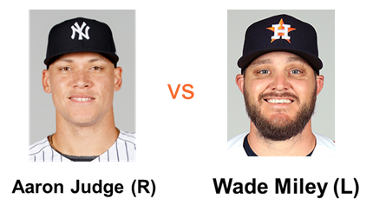
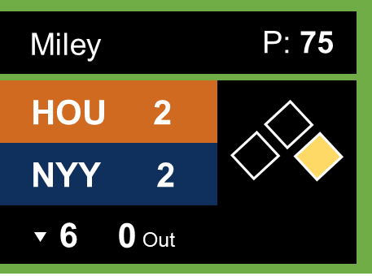
Singlearity-PA: Example prediction
June 22, 2019
Yankee Stadium (79℉)
2021 SABR Analytics Conference

Slide 11
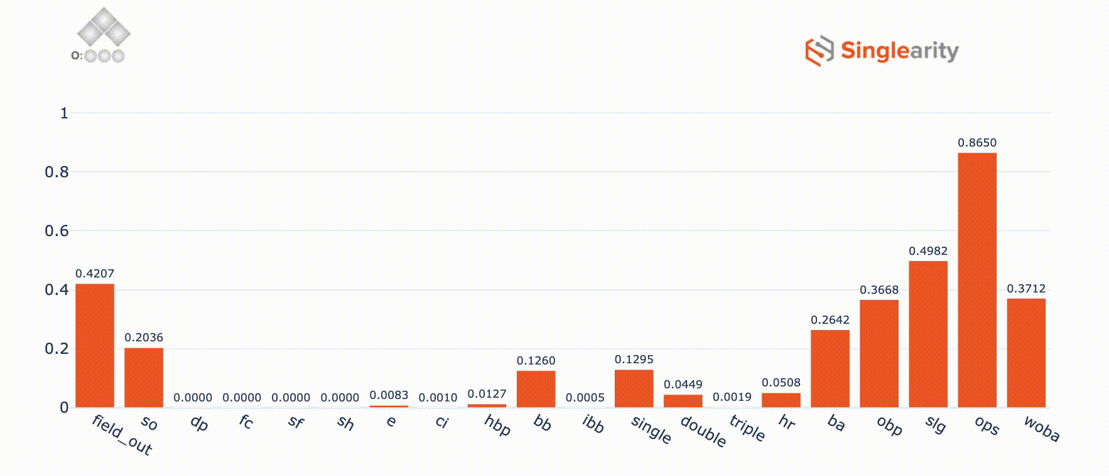
Singlearity-PA: Understands Game Rules and Strategy
Singlearity-PA understands and predicts:
Rules and scorekeeping
Double plays
Fielder’s choice
Sacrifice flies
Strategy
Intentional walks
Pitching around the batter
Sacrifice bunts
Click “Play” on the graph above to see how probabilities change as we vary the outs and base-states
2021 SABR Analytics Conference
© 2021 Privileged and Confidential

Slide 12
Singlearity-PA Results
Compare Singlearity-PA error rates against log5 and a simplistic LeagueAverage model
RMSE Error Rate (Lower is better)
Categorical X-Entropy Loss (Lower is better)
Categorical X-Entropy Loss (Lower is better)
Conclusion:
Singlearity-PA does better than other models. log5 is worse than simplistic LeagueAverage model.
2021 SABR Analytics Conference

Slide 13
Singlearity-PA Outperforms Other Models
Model Error Rates (Lower is better)
Type of PA Matchup | Model Name | wOBA | HR | BB
All | Singlearity-PA | 0.5091 | 0.05439 | 0.1149
 | log5 | 0.5151 | 0.05867 | 0.1208
 | LeagueAverage | 0.5111 | 0.05627 | 0.1184
2021 SABR Analytics Conference

Slide 14
Singlearity-PA Outperforms Other Models
Model Error Rates (Lower is better)
Type of PA Matchup | Model Name | wOBA | HR | BB
All | Singlearity-PA | 0.5091 | 0.05439 | 0.1149
 | log5 | 0.5151 | 0.05867 | 0.1208
 | LeagueAverage | 0.5111 | 0.05627 | 0.1184
“Everyday Players” (18% of all PAs) | Singlearity-PA | 0.5269 | 0.06100 | 0.1135
 | log5 | 0.5287 | 0.06240 | 0.1139
 | LeagueAverage | 0.5280 | 0.06250 | 0.1170
2021 SABR Analytics Conference

Slide 15
Singlearity-PA Outperforms Other Models
Model Error Rates (Lower is better)
Type of PA Matchup | Model Name | wOBA | HR | BB
All | Singlearity-PA | 0.5091 | 0.05439 | 0.1149
 | log5 | 0.5151 | 0.05867 | 0.1208
 | LeagueAverage | 0.5111 | 0.05627 | 0.1184
“Everyday Players” (18% of all PAs) | Singlearity-PA | 0.5269 | 0.06100 | 0.1135
 | log5 | 0.5287 | 0.06240 | 0.1139
 | LeagueAverage | 0.5280 | 0.06250 | 0.1170
“Occasional Players” (61% of all PAs) | Singlearity-PA | 0.5098 | 0.05440 | 0.1155
 | log5 | 0.5120 | 0.05638 | 0.1163
 | LeagueAverage | 0.5111 | 0.05990 | 0.1185
2021 SABR Analytics Conference

Slide 16
Singlearity-PA Outperforms Other Models
Model Error Rates (Lower is better)
Type of PA Matchup | Model Name | wOBA | HR | BB
All | Singlearity-PA | 0.5091 | 0.05439 | 0.1149
 | log5 | 0.5151 | 0.05867 | 0.1208
 | LeagueAverage | 0.5111 | 0.05627 | 0.1184
“Everyday Players” (18% of all PAs) | Singlearity-PA | 0.5269 | 0.06100 | 0.1135
 | log5 | 0.5287 | 0.06240 | 0.1139
 | LeagueAverage | 0.5280 | 0.06250 | 0.1170
“Occasional Players” (61% of all PAs) | Singlearity-PA | 0.5098 | 0.05440 | 0.1155
 | log5 | 0.5120 | 0.05638 | 0.1163
 | LeagueAverage | 0.5111 | 0.05990 | 0.1185
”Infrequent Players” (21% of all PAs) | Singlearity-PA | 0.4925 | 0.04911 | 0.1145
 | log5 | 0.5120 | 0.06176 | 0.1383
 | LeagueAverage | 0.4968 | 0.05180 | 0.1192
Conclusion: Singlearity-PA outperforms other models when predicting PAs among everyday players and infrequent players.
2021 SABR Analytics Conference

Slide 17
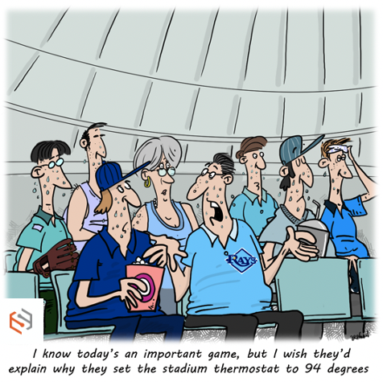
Explainability
2021 SABR Analytics Conference

Slide 18
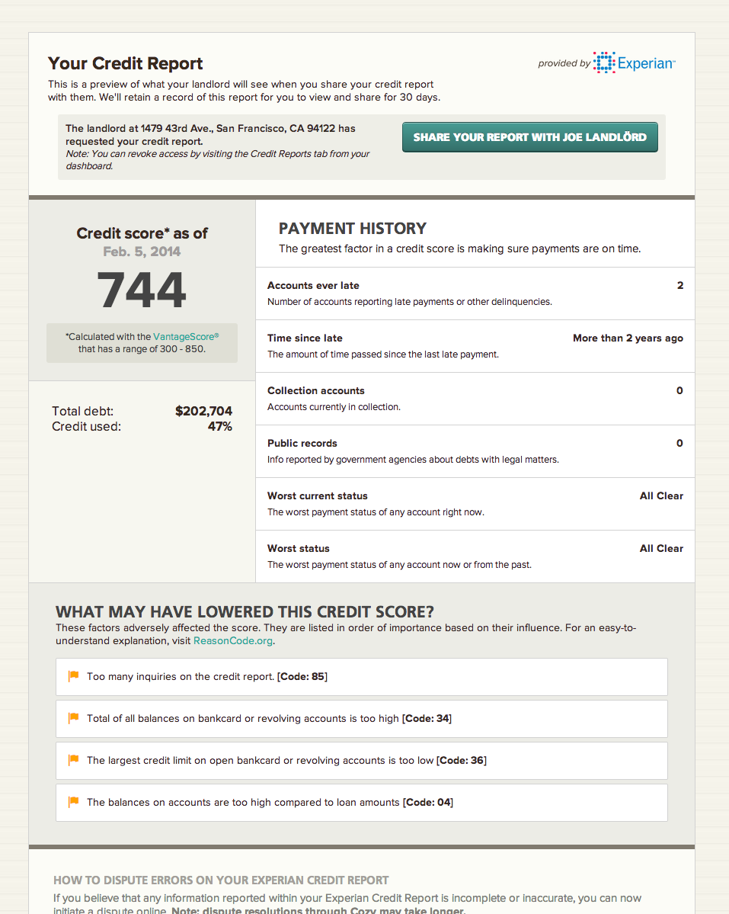
Explainability: You’ve Seen It Before
2021 SABR Analytics Conference

Slide 19
Explainability
Making the rationale behind predictions understandable to humans
Trust People must understand model’s decision process to be confident to make and defend decisions. | Insight & Learning We often have intuition or rules-of-thumb about how things work. An explainable model helps update our mental model. | Debuggability Occasionally, model may produce a result that is clearly wrong. By following model’s reasoning, we can evaluate improvements or potential additions to our inputs.
2021 SABR Analytics Conference

Slide 20
Explainability
Making the rationale behind predictions understandable to humans
Trust People must understand model’s decision process to be confident to make and defend decisions. | Insight & Learning We often have intuition or rules-of-thumb about how things work. An explainable model helps update our mental model. | Debuggability Occasionally, model may produce a result that is clearly wrong. By following model’s reasoning, we can evaluate improvements or potential additions to our inputs.
2021 SABR Analytics Conference

Slide 21
Explainability
Making the rationale behind predictions understandable to humans
Trust People must understand model’s decision process to be confident to make and defend decisions. | Insight & Learning We often have intuition or rules-of-thumb about how things work. An explainable model helps update our mental model. | Debuggability Occasionally, model may produce a result that is clearly wrong. By following model’s reasoning, we can evaluate improvements or potential additions to our inputs.
2021 SABR Analytics Conference

Slide 22
Explainability
Making the rationale behind predictions understandable to humans
Trust People must understand model’s decision process to be confident to make and defend decisions. | Insight & Learning We often have intuition or rules-of-thumb about how things work. An explainable model helps update our mental model. | Debuggability Occasionally, model may produce a result that is clearly wrong. By following model’s reasoning, we can evaluate improvements or potential additions to our inputs.
2021 SABR Analytics Conference

Slide 23
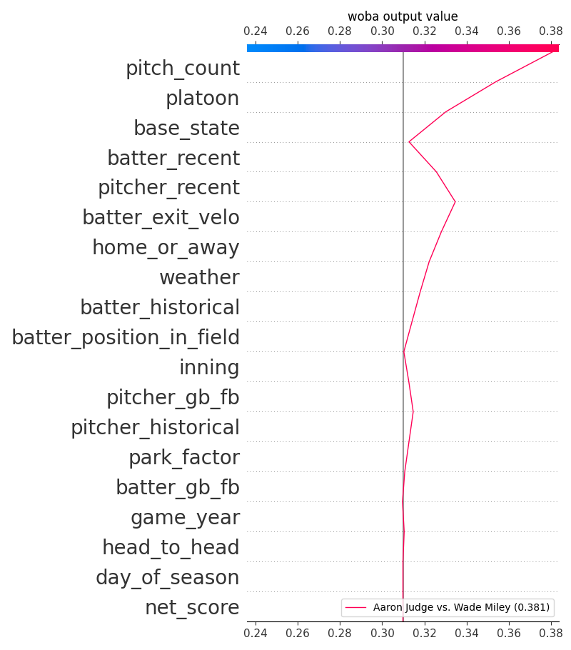
Inside the Black Box: Shapley Values for a Specific Prediction
Most important
wOBA output value
Shapley values:
Allow for measuring an input’s marginal contribution to the predicted outcome
Implemented by computing the result had the input been an “average” value
June 22, 2019
Yankee Stadium (79℉)
Least important
2021 SABR Analytics Conference
Notes:
Lloyd Shapley invented the concept in 1953 and widely used in economics and game-theory.
Shapley won the Nobel Prize in Economics in 1992 for this work.
Shapley values were recently (2017) applied to AI models to explain a model “from the outside”.

Slide 24
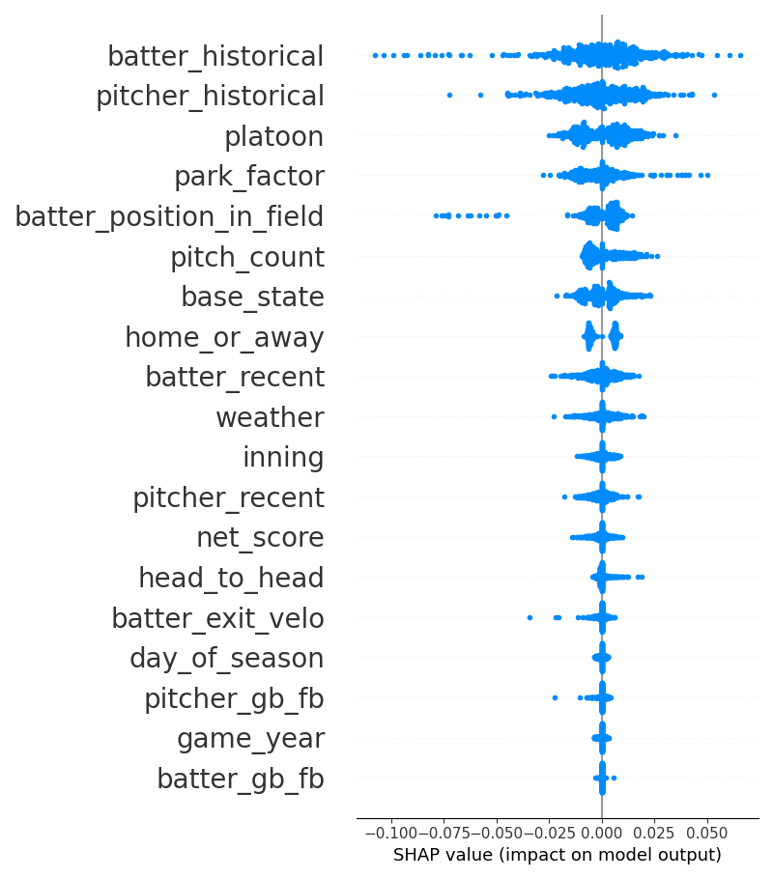
Inside the Black Box: Shapley Values for Global Feature Importance
wOBA prediction
Most important
Global feature importance measures the average contribution of an input to a prediction
Implemented by sampling a subset of predictions
Least important
2021 SABR Analytics Conference

Slide 25
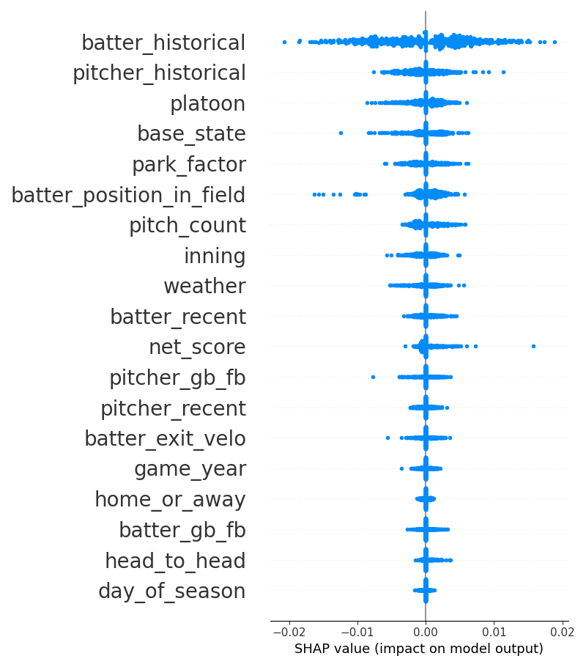
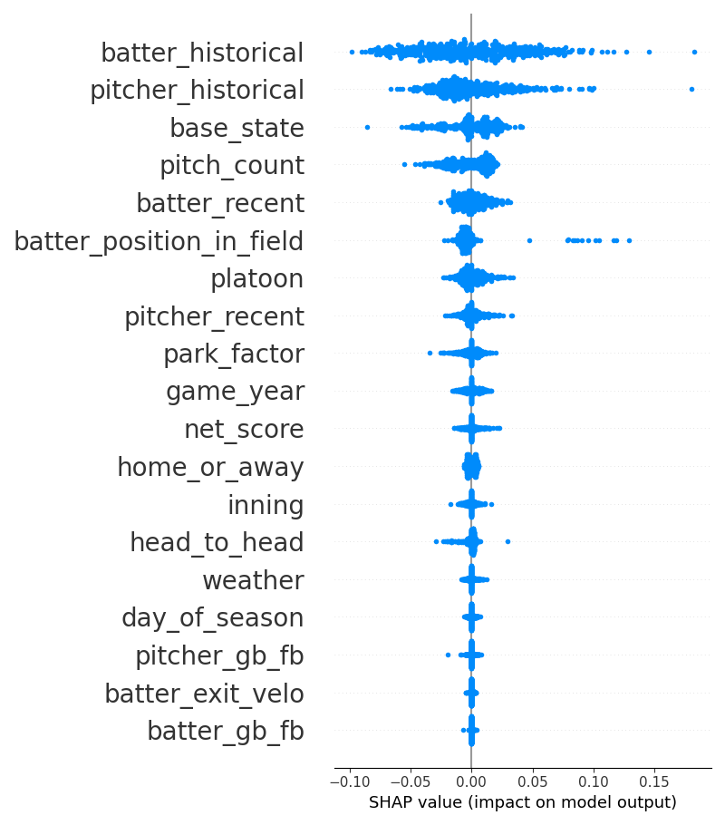
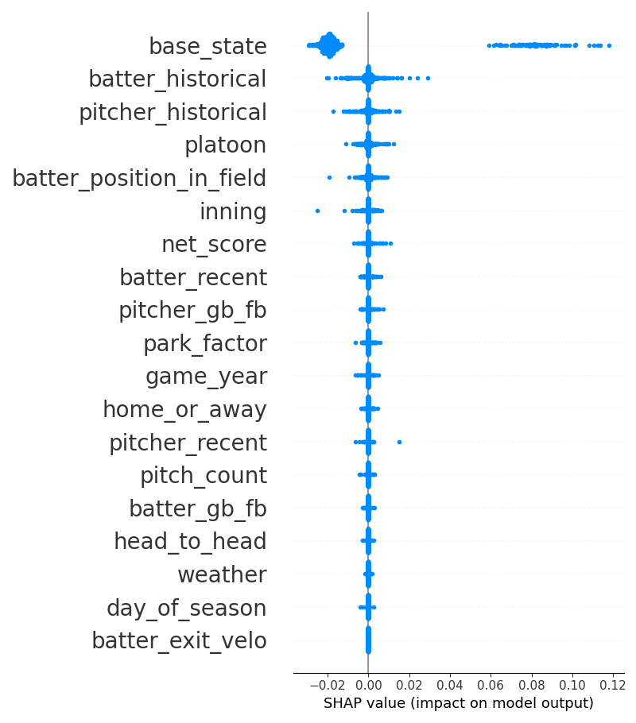
Global Feature Importance for Different Predictions
Most important
HR prediction
SO prediction
DP prediction
Least important
2021 SABR Analytics Conference

Slide 26
Strategies
2021 SABR Analytics Conference
Notes:
PPT: Add an interesting icon for History and for Limitations
Haechrel uses 365-day average rate-per-plate appearance

Slide 27
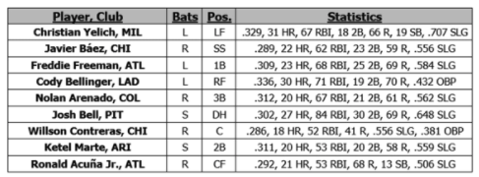
Using Singlearity-PA to Build Complex Strategies and Predictions
2019 All-Star Game NL Batting Order
vs
Justin Verlander (R)
Sample Questions
How many runs will the NL score in the 1st inning?
What is the optimal batting order?
In extra innings with a runner starting on 2B and Freddie Freeman leading off, who should be brought in to pitch?
What is the probability that Nolan Arenado hits a HR in the first inning?
What is the probability that Justin Verlander K’s at least one batter?
2021 SABR Analytics Conference

Slide 28
Previous Work on Run Prediction
2019 RE24
Run expectancy based on 24 base-out states (RE24)
Generated using historical data to calculate average runs scored from any state until end of inning
Used in variety of applications including the basis for calculating WAR (Wins Above Replacement)
Base Runners |  |  | Outs
1B | 2B | 3B | 0 outs | 1 out | 2 outs
- | - | - | 0.544 | 0.298 | 0.115
1B | - | - | 0.935 | 0.564 | 0.242
- | 2B | - | 1.147 | 0.713 | 0.339
1B | 2B | - | 1.537 | 0.979 | 0.467
- | - | 3B | 1.369 | 0.953 | 0.391
1B | - | 3B | 1.759 | 1.219 | 0.518
- | 2B | 3B | 1.971 | 1.368 | 0.615
1B | 2B | 3B | 2.361 | 1.634 | 0.743
RE24 is independent of pitcher quality, batting lineup, ballpark, weather, etc.
2021 SABR Analytics Conference
Notes:
PPT: Can you add a graphic like ”warning” or “limitations” to the “But:” section

Slide 29
Using Markov Chains to Model Baseball
Main idea
Use PA predictions to generate transition probabilities between states
2021 SABR Analytics Conference
Notes:
Baserunning assumptions (detailed in https://github.com/singlearity-sports/singlearity-R/blob/master/markov/tmatrix_std.R):
Error - 85% are 1 base error and 15% are 2 base error
Runner on 1B goes to 3B on a single 30% of the time
Run on 2B scores on a single 38% of the time
Runner on 2B goes to 3B 25% of the time on a field out.
We assume that 85% of the errors are one-base errors and the remaining 15% are two-base errors.

Slide 30
Using Markov Chains to Model Baseball
Main idea
Use PA predictions to generate transition probabilities between states
1
1
Example transition probability = Pr(1B) + Pr(BB) + Pr(IBB) + Pr(Error) + Pr(HBP) + Pr(CI)
2021 SABR Analytics Conference
Notes:
Baserunning assumptions (detailed in https://github.com/singlearity-sports/singlearity-R/blob/master/markov/tmatrix_std.R):
Error - 85% are 1 base error and 15% are 2 base error
Runner on 1B goes to 3B on a single 30% of the time
Run on 2B scores on a single 38% of the time
Runner on 2B goes to 3B 25% of the time on a field out.
We assume that 85% of the errors are one-base errors and the remaining 15% are two-base errors.

Slide 31
Using Markov Chains to Model Baseball
Until now, transition probabilities were too simplistic, making Markov chain predictions inaccurate
Main idea
Use PA predictions to generate transition probabilities between states
Generate expected runs for the half inning
Can generate other probabilities such as # of hits expected
1
1
Example transition probability = Pr(1B) + Pr(BB) + Pr(IBB) + Pr(Error) + Pr(HBP) + Pr(CI)
2021 SABR Analytics Conference
Notes:
Baserunning assumptions (detailed in https://github.com/singlearity-sports/singlearity-R/blob/master/markov/tmatrix_std.R):
Error - 85% are 1 base error and 15% are 2 base error
Runner on 1B goes to 3B on a single 30% of the time
Run on 2B scores on a single 38% of the time
Runner on 2B goes to 3B 25% of the time on a field out.
We assume that 85% of the errors are one-base errors and the remaining 15% are two-base errors.

Slide 32
Comparing Singlearity-Markov to RE24
Methodology
Limit to 1st inning (avoiding complications of pinch-hitters, relief pitchers, walk-off endings)
Compute RMSE error rate of predicted vs. actual runs through the end of the half inning for each PA
2021 SABR Analytics Conference
© 2021 Privileged and Confidential

Slide 33
Comparing Singlearity-Markov to RE24
Methodology
Limit to 1st inning (avoiding complications of pinch-hitters, relief pitchers, walk-off endings)
Compute RMSE error rate of predicted vs. actual runs through the end of the half inning for each PA
Initial Results and Adjustment
Singlearity-Markov consistently undershoots runs scored by 12-15% - it doesn’t model wild pitches, stolen bases, runner advancements
Singlearity vs RE24 RMSE error rate (lower is better)
Year | RE24 | Singlearity-Markov
2017 | 1.01307 | 1.01735
2018 | 0.95021 | 0.94880
2019 | 1.00832 | 1.01322
2020 | 0.92545 | 0.92456
Overall | 0.98412 | 0.98644
2021 SABR Analytics Conference
© 2021 Privileged and Confidential

Slide 34
Comparing Singlearity-Markov to RE24
Methodology
Limit to 1st inning (avoiding complications of pinch-hitters, relief pitchers, walk-off endings)
Compute RMSE error rate of predicted vs. actual runs through the end of the half inning for each PA
Initial Results and Adjustment
Singlearity-Markov consistently undershoots runs scored by 12-15% - it doesn’t model wild pitches, stolen bases, runner advancements
Created Singlearity-MarkovAdjusted using previous year’s undershoot
Singlearity vs RE24 RMSE error rate (lower is better)
Year | RE24 | Singlearity-Markov | Singlearity-MarkovAdjusted
2017 | 1.01307 | 1.01735 | 1.01199
2018 | 0.95021 | 0.94880 | 0.94593
2019 | 1.00832 | 1.01322 | 1.00684
2020 | 0.92545 | 0.92456 | 0.92357
Overall | 0.98412 | 0.98644 | 0.98192
Singlearity-MarkovAdjusted uses pitcher quality, batting lineup, ballpark,
weather (and more) to create more accurate predictions
2021 SABR Analytics Conference
© 2021 Privileged and Confidential

Slide 35
Generating an Optimal Lineup
Order | Actual Lineup
1 | Christian Yelich
2 | Javier Báez
3 | Freddie Freeman
4 | Cody Bellinger
5 | Nolan Arenado
6 | Josh Bell
7 | Willson Contreras
8 | Ketel Marte
9 | Ronald Acuña Jr.
2021 SABR Analytics Conference

Slide 36
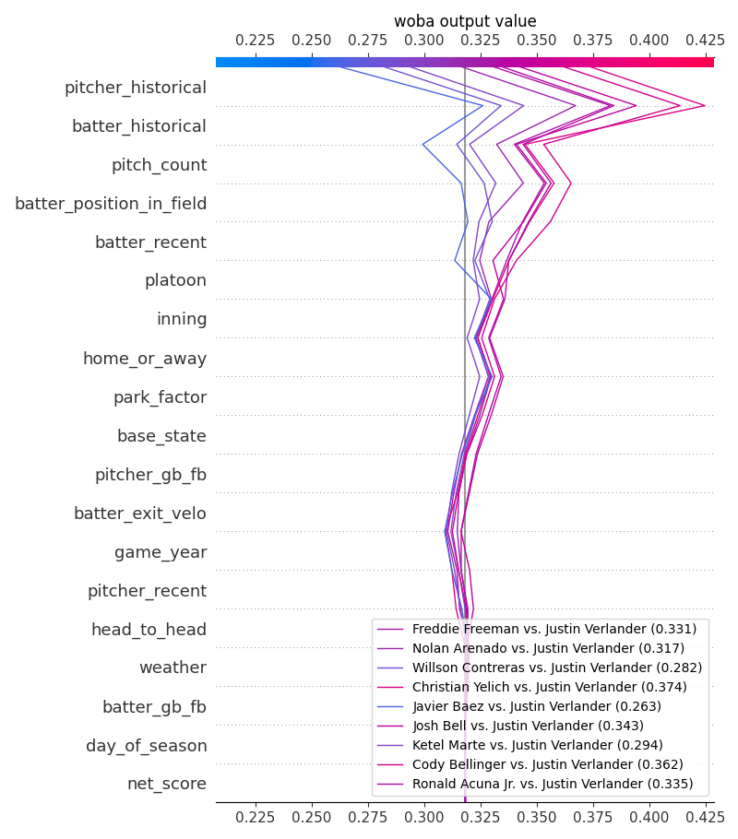
Generating an Optimal Lineup
Order | Actual Lineup
1 | Christian Yelich
2 | Javier Báez
3 | Freddie Freeman
4 | Cody Bellinger
5 | Nolan Arenado
6 | Josh Bell
7 | Willson Contreras
8 | Ketel Marte
9 | Ronald Acuña Jr.
Iterate through 9-factorial permutations of lineups to generate run probabilities for the 1st inning
2021 SABR Analytics Conference

Slide 37
Generating an Optimal Lineup
Order | Actual Lineup | Optimal Lineup
1 | Christian Yelich | Ronald Acuña Jr.
2 | Javier Báez | Christian Yelich
3 | Freddie Freeman | Cody Bellinger
4 | Cody Bellinger | Josh Bell
5 | Nolan Arenado | Nolan Arenado
6 | Josh Bell | Ketel Marte
7 | Willson Contreras | Freddie Freeman
8 | Ketel Marte | Willson Contreras
9 | Ronald Acuña Jr. | Javier Báez
Expected 1st inning runs | 0.51101 | 0.54493
Iterate through 9-factorial permutations of lineups to generate run probabilities for the 1st inning
Can extend model to predict outcomes for entire games by modelling player substitutions
Singlearity-Markov generated 6.7% more runs than actual lineup
2021 SABR Analytics Conference

Slide 38
Final Thoughts
2021 SABR Analytics Conference

Slide 39
Future Work
Enhancement | Improved Prediction/Strategy
Add minor league & international league stats | Improve predictions for new MLB players
Add data on batter and baserunners’ speed | Improve prediction of double plays, doubles/triples and sacrifice flies, and model stolen bases
Add data on fielding quality | Evaluate defensive substitutions
Incorporate current game stats | Model effects of same-game performance (e.g., Blake Snell in Game 6 of 2020 World Series)
Incorporate stats of on-deck batters | Model effects of “pitching around the batter"
Account for pitcher control | Allow Singlearity-Markov to model wild pitches
Accurately model the game beyond half-innings | Create more advanced models and strategies for player substitutions and roster formation
2021 SABR Analytics Conference

Slide 40
Conclusion
Neural Networks are a powerful new mechanism to analyze massive amounts of baseball data to enable better predictions and reveal new insights.
Trust People must understand model’s decision process to be confident to make and defend decisions. | Insight & Learning We often have intuition or rules-of-thumb about how things work. An explainable model helps update our mental model. | Debuggability Occasionally, model may produce a result that is clearly wrong. By following model’s reasoning, we can evaluate improvements or potential additions to our inputs.
2021 SABR Analytics Conference

Slide 41
Singlearity: Explore it
Demo Simulate your own plate PA matchups at https://dash.singlearity.com
APIs and Singlearity Service
https://github.com/singlearity-sports/singlearity-R
https://github.com/singlearity-sports/singlearity-python
Libraries to programmatically access Singlearity predictions. Includes examples and visualizations. (API Key required)
Open Source View and modify open source (MIT License) code for Markov chains using Singlearity-PA predictions or alternative PA predictions https://github.com/singlearity-sports/singlearity-R/tree/master/markov
2021 SABR Analytics Conference

